Slide 1

Digital Design
With an Introduction to the Verilog HDL, VHDL, and SystemVerilog
6th Edition, Global Edition
Chapter 01
Digital Systems and Binary Numbers

Slide 2
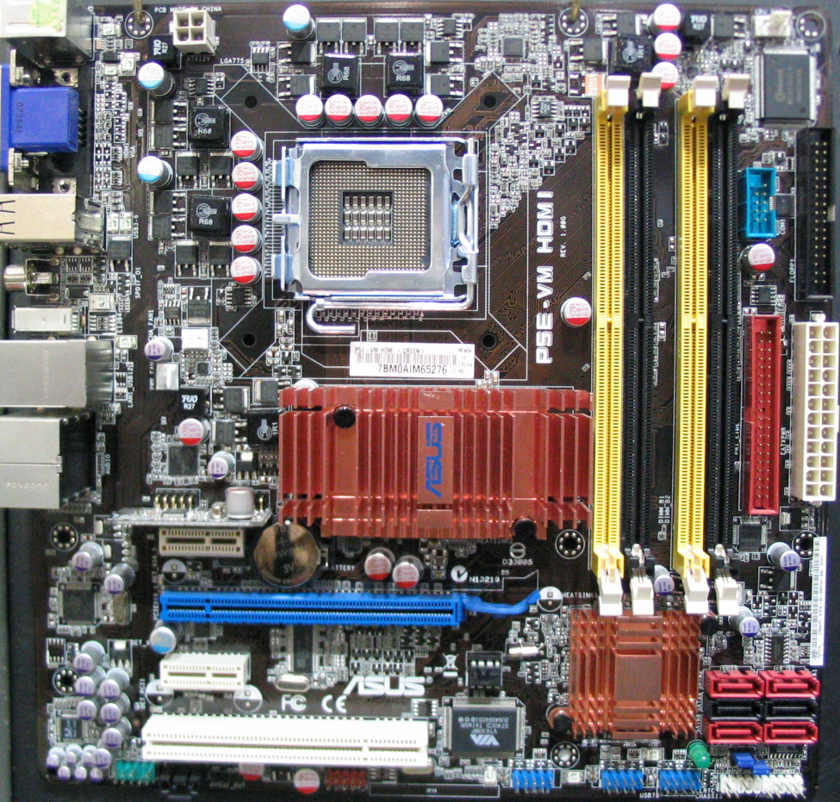

CPU

Slide 3
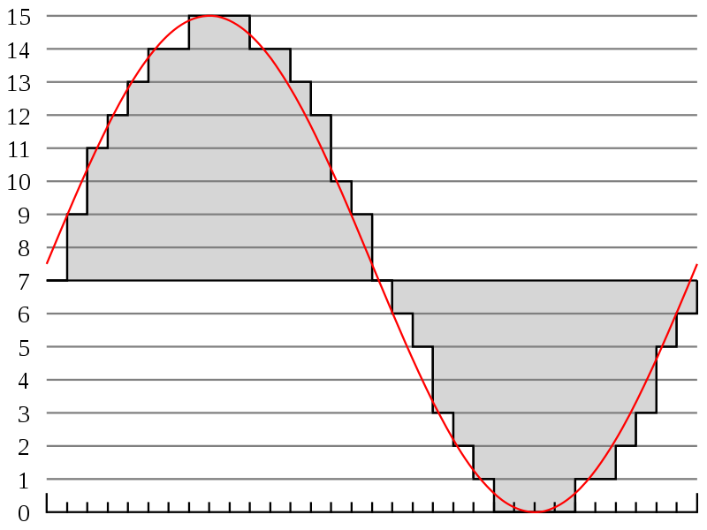
Analog/Digital
B = Byte
b = bit
1 B = 8 b

Slide 4
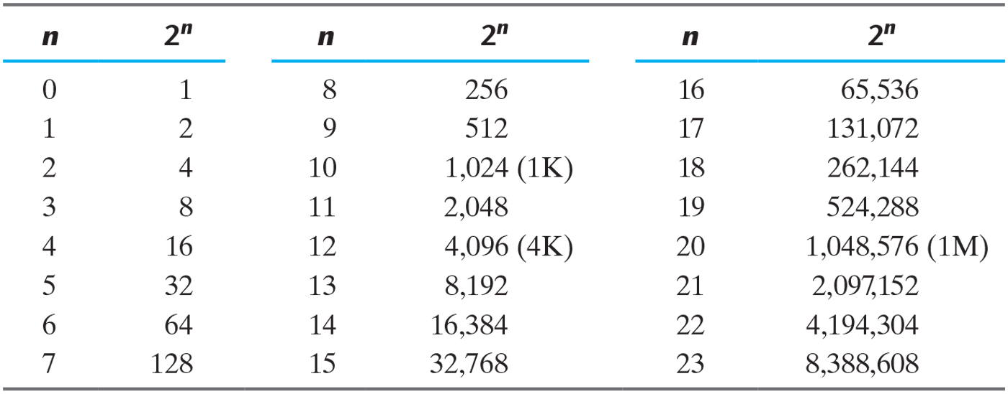
Powers of Two
2¹⁰= 1Kilo
Why is 2^{n}?
2²⁰ = 1Mega
2³⁰ = 1Giga
2⁴⁰ = 1Tera

Slide 5
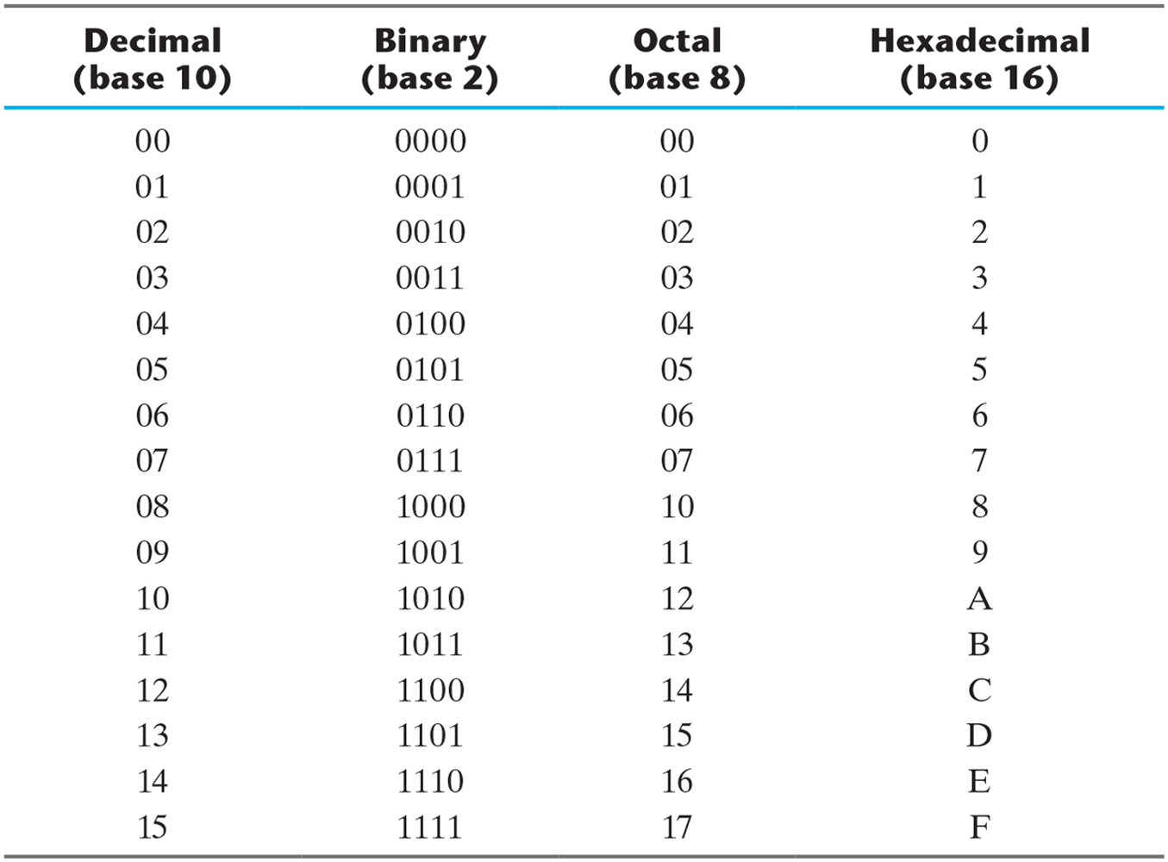
Numbers with Different Base

Slide 6
Number Base Conversion
a₅a₄a₃a₂a₁a₀.a₋₁a₋₂a₋₃
= a_{n}r^{n}+a_{n-1}r^{n-1}+...+a₂r²+a₁r+a₀+a₋₁r⁻¹+a₋₂r⁻²+...+a_{-m}r^{-m}
7392 = 7 × 10³ + 3 × 10² + 9 × 10¹ +2 × 10⁰
(11010.11)₂ =1×2⁴+1×2³+0×2²+1×2¹+0×2₀+1×2₋₁+1×2₋₂
= (26.75)₁₀

Slide 7
Number Base Conversion
Convert decimal 41 to binary.
answer : (41)10 = (a₅a₄a₃a₂a₁a₀)₂ = (101001)₂
answer : (41)10 = (a₅a₄a₃a₂a₁a₀)₂ = (101001)₂
 | Integer Quotient |  | Remainder | Coefficient
41/2 = | 20 | + | ½ | a₀ = 1
20/2 = | 10 | + | 0 | a₁ = 0
10/2 = | 5 | + | 0 | a₂ = 0
5/2 = | 2 | + | ½ | a₃ = 1
2/2 = | 1 | + | 0 | a₄ = 0
1/2 = | 0 | + | ½ | a₅ = 1
Integer | Remainder
41
20 | 1
10 | 0
5 | 0
2 | 1
1 | 0
0 | 1
Answer
=101001

Slide 8
Number Base Conversion
Convert decimal 153 to octal.
Convert (0.6875)10 to binary.
153
19 | 1
2 | 3
0 | 2 = (231)₈
 | Integer |  | Fraction | Coefficient
0.6875*2 = | 1 | + | 0.3750 | a₋₁ = 1
0.3750*2 = | 0 | + | 0.7500 | a₋₂ = 0
0.7500*2 = | 1 | + | 0.5000 | a₋₃ = 1
0.5000*2 = | 1 | + | 0.0000 | a₋₄ = 1
Answer:(0.6875)₁₀ = (0.a₋₁a₋₂a₋₃a₋₄)₂ = (0.1011)₂

Slide 9
Octa – Hex Number Conversion
( 10 110 001 101 011 . 111 100 000 110 )₂ = (26153.7460)₈
2 6 1 5 3 7 4 0 6
( 10 1100 0110 1011 . 1111 0010 )₂ = (2C6B.F2)₁₆
2 C 6 B F 2

Slide 10
Complements
(r-1)’s complements of N is (r^{n}-1)-N
r=10, r-1=9, 9’complements of N is (10^{n}-1)-N
Ex) the 9’s complements of 546700 is 999999-546700 = 453299
the 9’s complements of 012398 is 999999-012398 = 987601
For binary number, r=2, r-1=1
1’complements of N is (2^{n}-1)-N
Ex) the 1’s complements of 1011000 is 0100111
the 1’s complements of 0101101 is 1010010

Slide 11
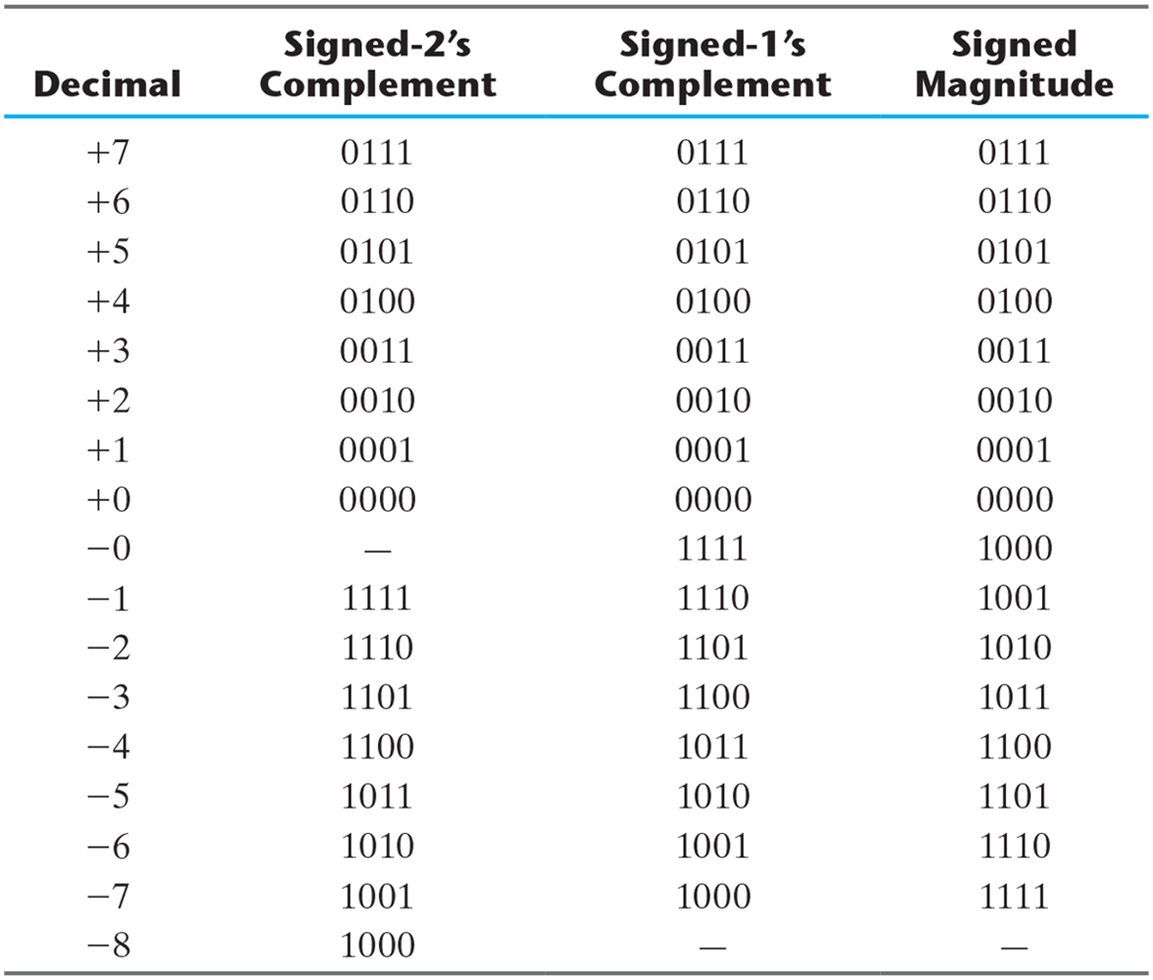
Signed Binary Numbers

Slide 12
Subtraction with Complements
X=1010100, Y=1000011, (a) X-Y, (b) Y-X
(a) X-Y
(b) Y-X
X = | 1010100
2’s complement of Y = | +0111101
Sum = | 10010001
Discard end carry 2⁷ = | -10000000
Answer: X-Y = | 0010001
Y = | 1000011
2’s complement of X = | +0101100
Sum = | 1101111
There is no carry.
The answer is Y-X = -(2’s complement of 1101111)=-0010001

Slide 13
Signed Binary Numbers
Arithmetic Addition
signed-magnitude system follows the rules of ordinary arithmetic
signed-complement system requires only addition.
+6 |  | 00000110 |  | -6 |  | 11111010
+13 |  | 00001101 |  | +13 |  | 00001101
+19 |  | 00010011 |  | +7 |  | 00000111
+6 |  | 00000110 |  | -6 |  | 11111010
-13 |  | 11110011 |  | -13 |  | 11110011
-7 |  | 11111001 |  | -19 |  | 11101101

Slide 14
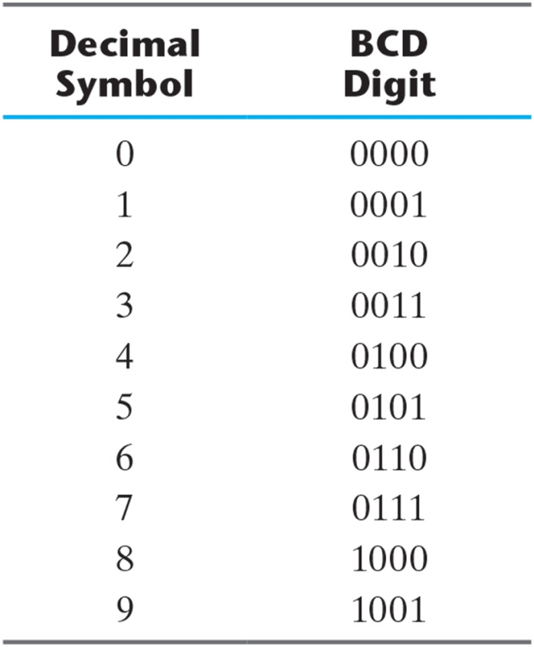
Binary-Coded Decimal (BCD).

Slide 15
Binary Code – BCD Code
the 4-bit code for one decimal
(185)₁₀ = (0001 1000 0101)_{BCD} = (10111001)₂
BCD Addition
If the binary sum is greater or equal to 1010, we add 0110 to obtain the correct BCD
4 |  | 0100 |  | 4 |  | 0100 |  | 8 |  | 1000
+5 |  | +0101 |  | +8 |  | +1000 |  | +9 |  | +1001
9 |  | 1001 |  | 12 |  | 1100 |  | 17 |  | 10001
 |  |  |  |  |  | +0110 |  |  |  | +0110
 |  |  |  |  |  | 10010 |  |  |  | 10111

Slide 16
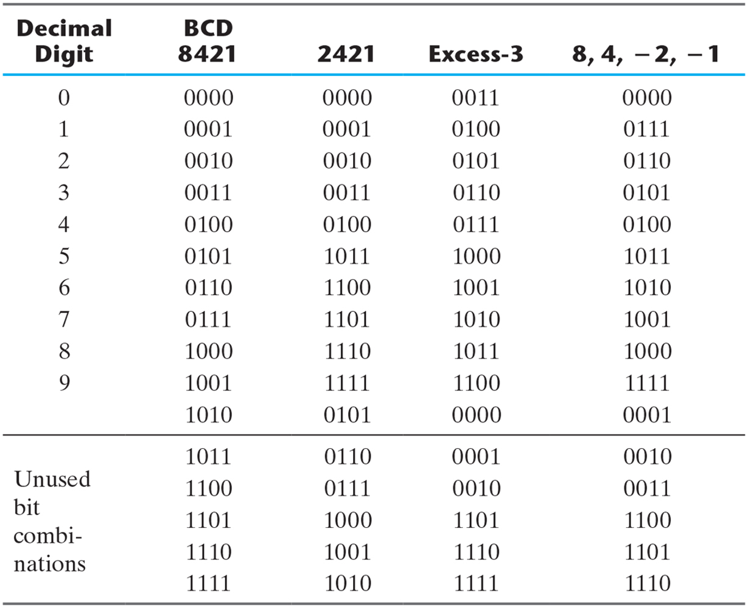
Four Different Binary Codes for the Decimal Digits.

Slide 17
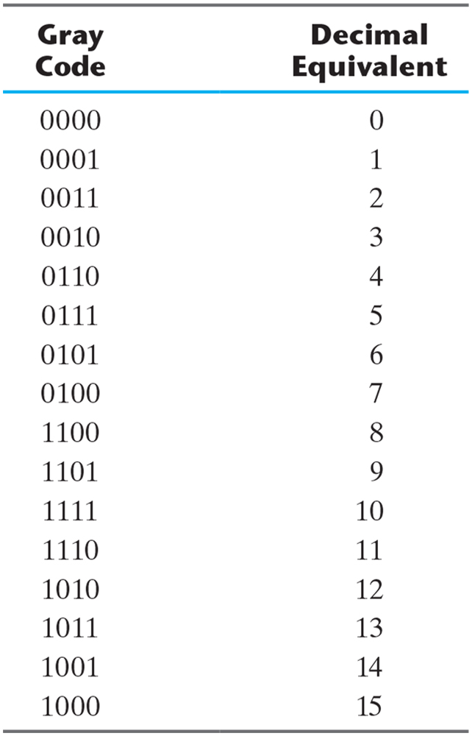
Gray Code

Slide 18
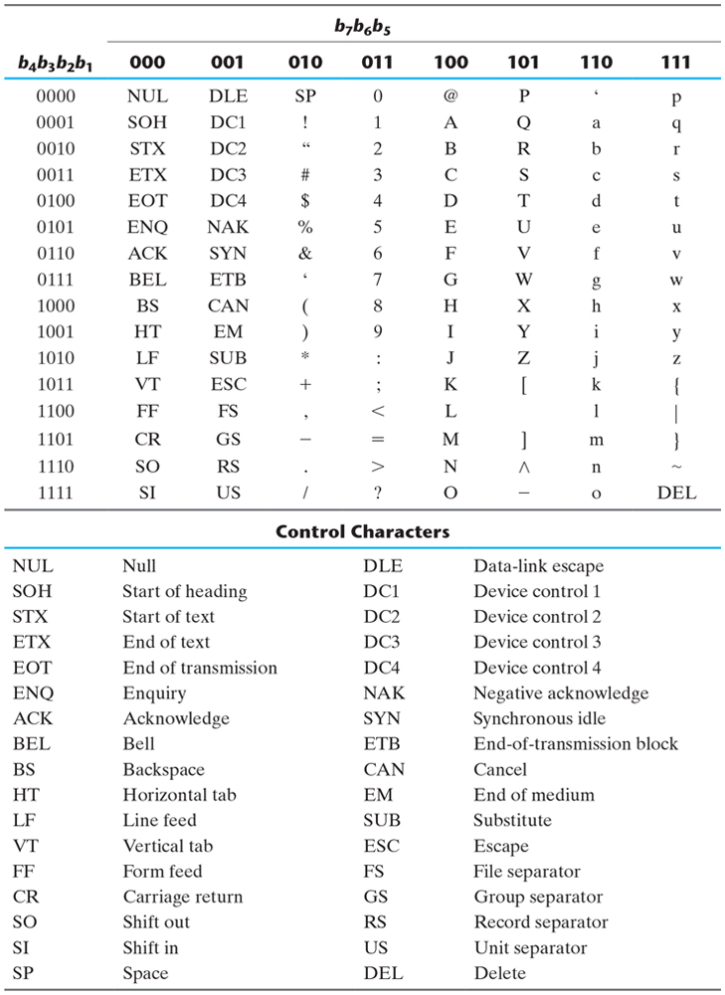
American Standard Code for Information Interchange (ASCII).

Slide 19
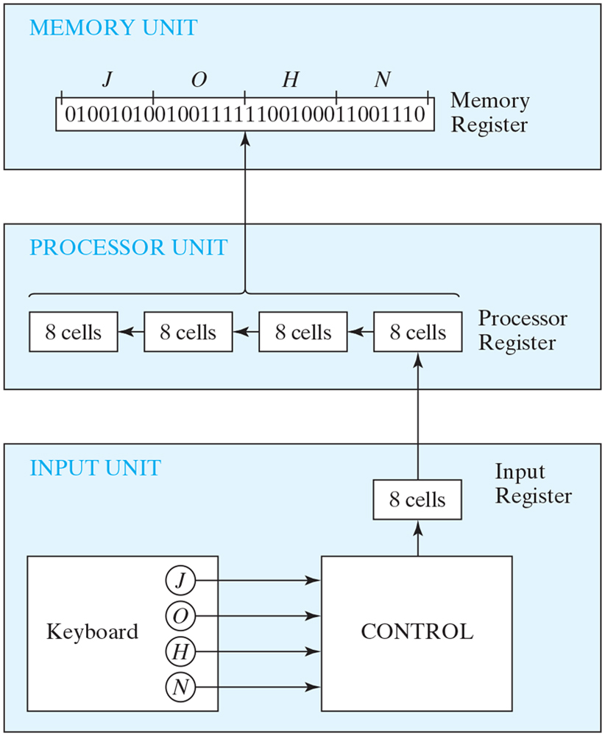
Transfer of information among registers.

Slide 20
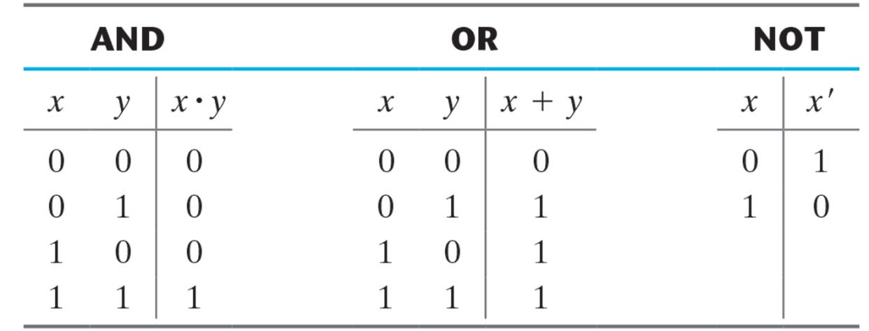
Truth Tables of Logical Operations

Slide 21
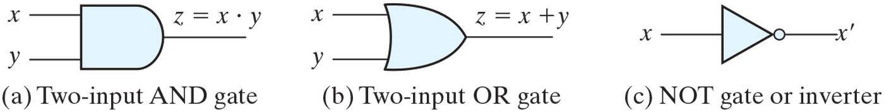
Symbols for digital logic circuits.

Slide 22
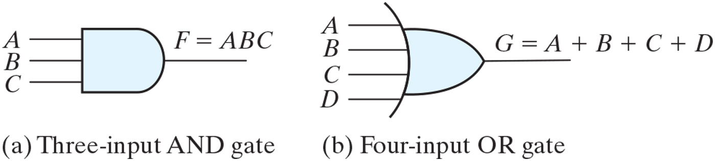
Gates with multiple inputs.

Slide 23
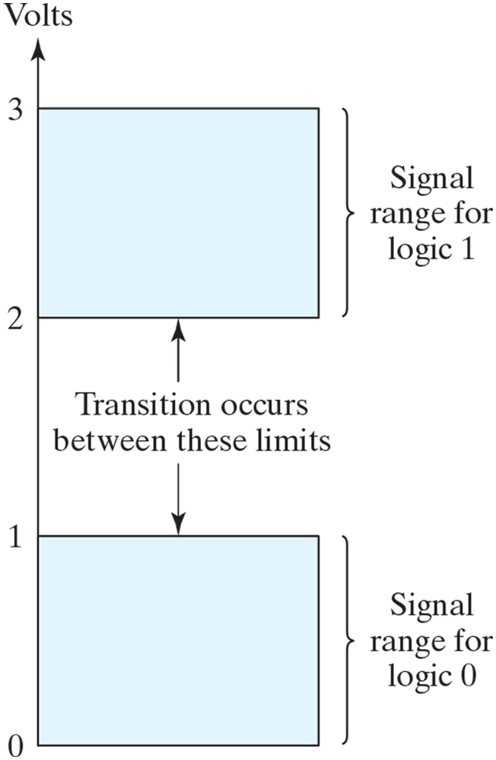
Signal levels for binary logic values.

Slide 24
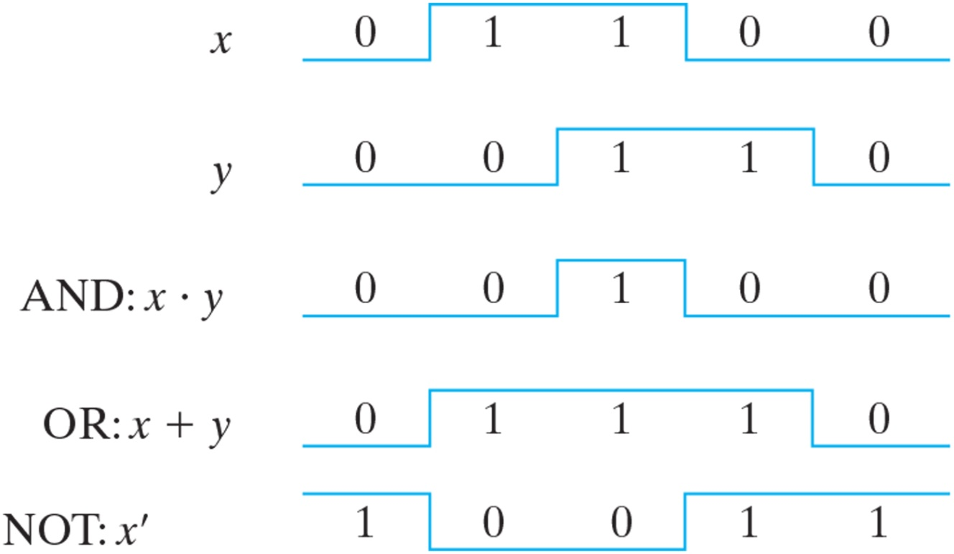
Input–output signals for gates.

